Slide 1

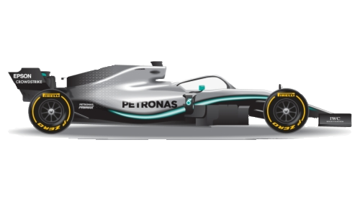
FORMULA 1:
AN ANALYSIS
BY TATIANA ALVEAL, SUSAN ABRAHAM, THOMAS GRESCO, EURIBIADES MOTA, & NANCY KORKOR SAKYI

Slide 2

Why is F1 important?
Highest speeds of all motorsport championships
Technological advances in F1 can make their way into regular cars
Improved fuel economy
Use of carbon fiber
KERS (hybrid motors)
Formula E (motorsport for electric cars) provides innovation for electric cars
Growing popularity in American media
Teams and drivers use lots of data to improve their cars and their races

Slide 3
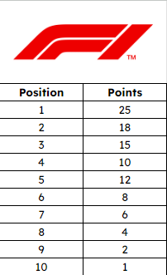
FORMULA 1 RULES
Two championships:
Driver’s championship
Constructor’s championship (Team championship)
Both championships run at the same time
Constructor’s championship
10 teams with 2 drivers each
Total 20 drivers
Each constructor builds a car to race throughout the season
Teams earn points based on the position their drivers finish the race in
The team with the most points at the end of the season wins
Driver’s Championship
The driver with the most point wins, regardless of where their team placed or of the other driver on their team
Drivers who finish in 11th place or below earn no points

Slide 4


Slide 5
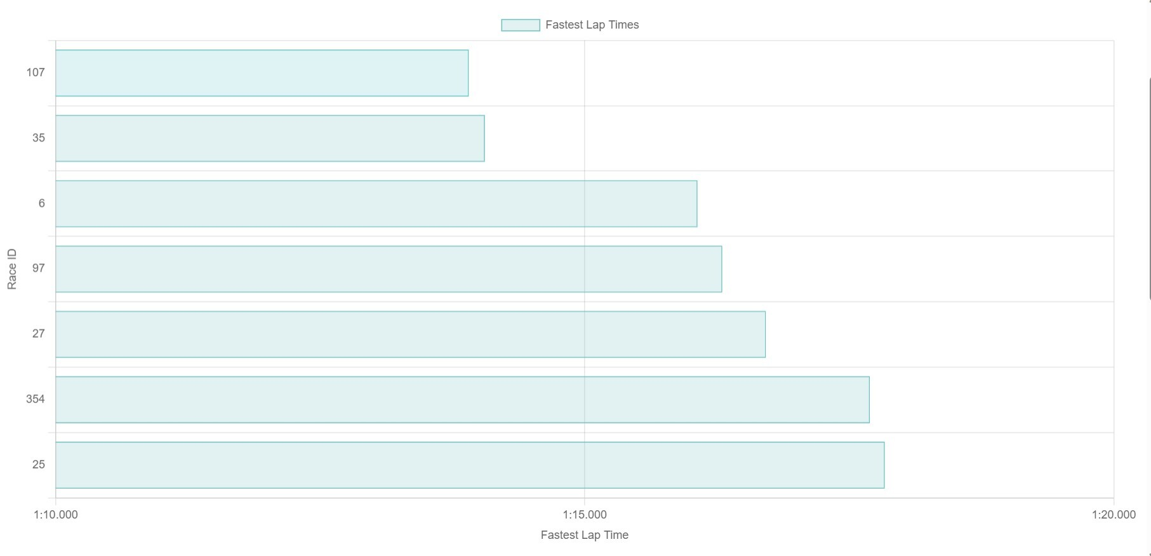

Slide 6
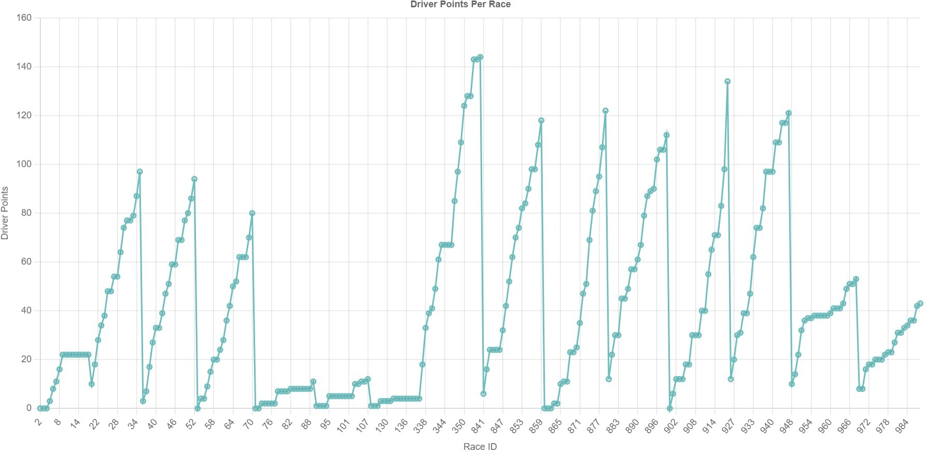

Slide 7
For further analysis
Break down driver and team standings into per year standings, instead of an aggregate
Add Formula 2 drivers (junior championship to Formula 1) to make the data more complete and more useful for teams
Include data on F1 speeds achieved during races for further analysis
Which tracks allow for faster speeds?
How does weather affect race speeds?
Could be used as a dashboard for F1 teams to find all F1 related data

